Slide 1
CHURN PREDICTION PROJECT
This project completed by:
Ronit Schwartz

Slide 2
The dataset contains the following columns:
1. customerID: Unique identifier for each customer.
2. Gender: Gender of the customer.
3. SeniorCitizen: Indicates if the customer is a senior citizen (0: No, 1: Yes).
4. Partner: Indicates if the customer has a partner.
5. Dependents: Indicates if the customer has dependents.
6. tenure: Number of months the customer has stayed with the company.
7. PhoneService: Indicates if the customer has phone service.
8. MultipleLines: Indicates if the customer has multiple lines.
9. InternetService: Type of internet service the customer has (DSL, Fiber optic, No).
10. OnlineSecurity: Indicates if the customer has online security.
11. OnlineBackup: Indicates if the customer has online backup.
12. DeviceProtection: Indicates if the customer has device protection.
13. TechSupport: Indicates if the customer has tech support.
14. StreamingTV: Indicates if the customer has streaming TV service.
15. StreamingMovies: Indicates if the customer has streaming movies service.
16. Contract: Type of contract the customer has (Month-to-month, One year, Two year).
17. PaperlessBilling: Indicates if the customer has paperless billing.
18. PaymentMethod: Payment method used by the customer.
19. MonthlyCharges: Monthly charges incurred by the customer.
20. TotalCharges: Total charges incurred by the customer.
21. Churn: Indicates if the customer has churned (Yes, No).

Slide 3
What we are trying to predict?
We are trying to predict customer churn, which refers to whether a customer will leave the telecom company or not. The target variable for prediction is `Churn`, which is a binary classification problem with values 1 (churn) and 0 (no churn).
Objective Predict customer churn based on their characteristics and subscribed services.
Importance: Customers are vital assets, and losing them due to high charges, better competitor offers, or poor service can harm a company. Churn analysis is essential because retaining customers is more cost-effective than acquiring new ones. It helps identify issues and develop strategies to improve customer retention.

Slide 4
What data is available for that (input)?
Demographic info about customers — gender, age range - In terms of Partner, Dependent and Senior Citizen
Customer account information — how long they’ve been a customer- tenure, contract type, payment method, paperless billing, monthly charges, and total charges
Services:
Phone service - If customer has Phone service, then services related to Phone like:
Multiline Phone service
Internet Service - If customer has Internet service, then services related to Internet like:
Online security
Online backup
Device protection
Tech support
Streaming TV
Streaming Movies
Churn - Whether customer left the company or still with the company?

Slide 5
Motivation & Applications
Motivation:
1. Cost Efficiency: Retaining existing customers is more cost-effective than acquiring new ones.
2. Improved Customer Experience: Understanding churn reasons helps enhance customer satisfaction.
3. Revenue Stability: Reducing churn leads to more predictable and stable revenue streams.
4. Competitive Advantage: Identifying and addressing churn factors can provide a competitive edge.
Applications
1. Targeted Marketing: Use churn predictions to create personalized retention campaigns.
2. Product Improvement: Identify service gaps and improve offerings based on churn analysis.
3. Resource Allocation: Allocate resources more effectively to areas that impact customer retention.
4. Strategic Decision-Making: Inform business strategies and policies with churn insights to improve overall performance.

Slide 6
How many examples are in the dataset?
How many examples are in the dataset? (train/test)
Total Examples: 7,043 customers
Training Set: 80%, which equals 5,634 examples
Testing Set: 20%, which equals 1,409 examples.
The number of features, excluding the label variable (Churn) and the unique identifier (customerID) is 19
How many features are in the dataset?

Slide 7
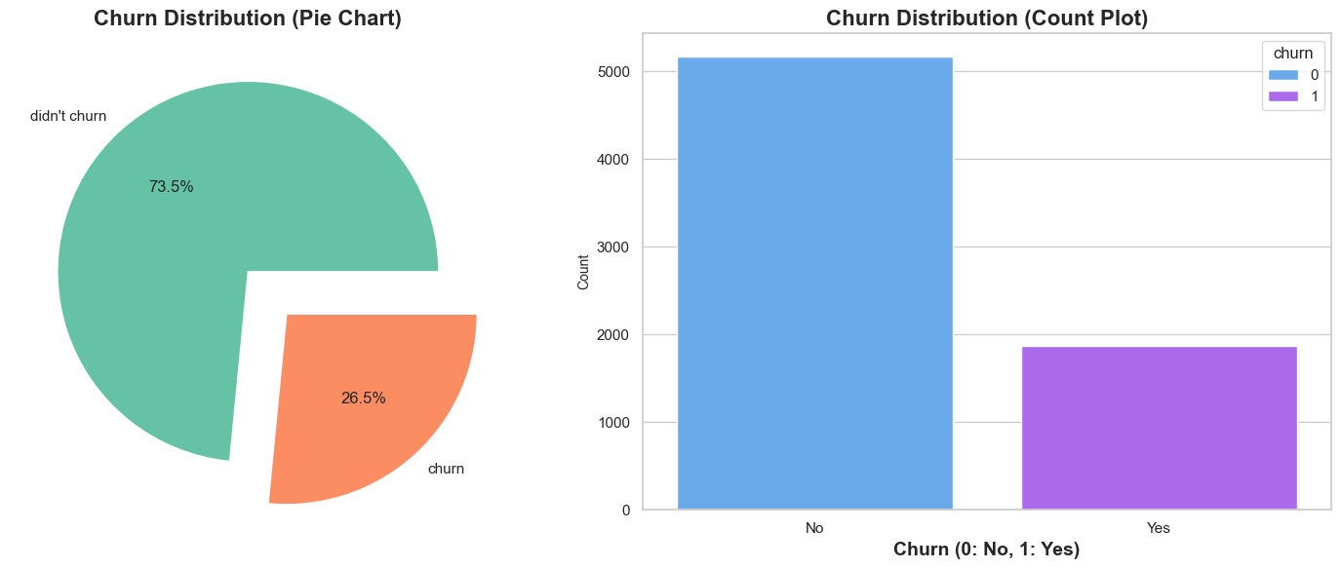
Distribution by churn label:
out of 7,043 customers, 1,869 churned, which corresponds to a churn rate of approximately 26.5%.

Slide 8
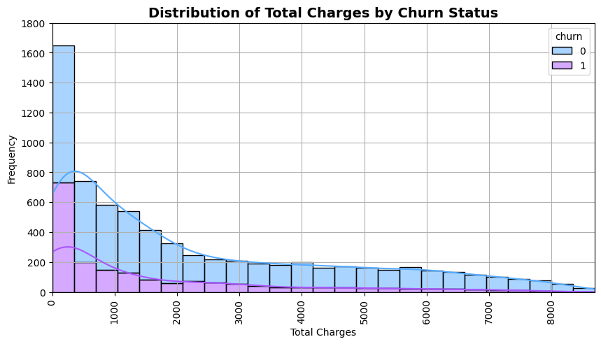
Are there any missing values?
The 'TotalCharges' column, which contains numerical values, is stored as a string data type. Errors occurred during its conversion to float due to empty strings. These issues primarily affect entries where 'tenure' is zero, likely representing new customers who haven't yet been invoiced. To address these missing values, we'll calculate 'TotalCharges' as the product of 'tenure' and 'MonthlyCharges’.
Total Charges Distribution by Churn:
The histogram of 'TotalCharges' reveals a right-skewed distribution: most customers have lower charges, with fewer incurring very high charges.
The mean total charges are approximately $2279.73, but there is a wide variation, as indicated by the standard deviation of $2266.79.
The median (50% quantile) is significantly lower than the mean, at $1394.55, highlighting the skewness of the distribution.

Slide 9
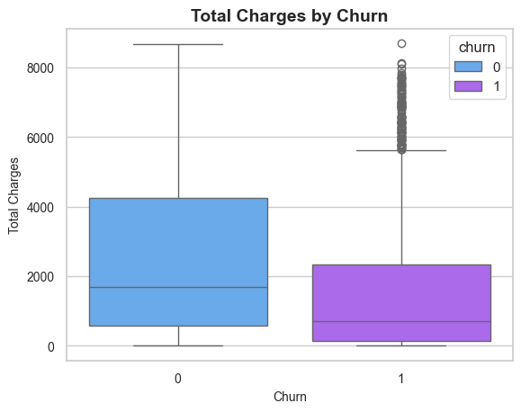
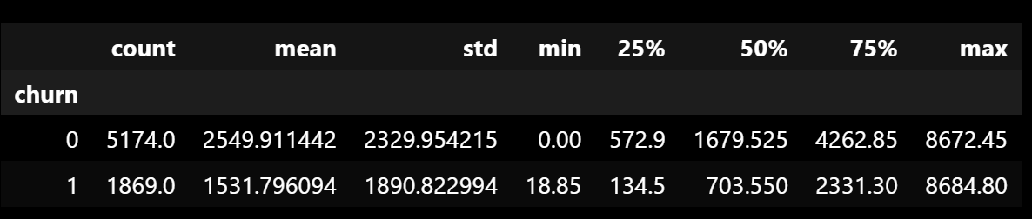
Total Charges Distribution by Churn:
Churn Distribution: Customers who churn tend to have lower total charges compared to those who do not churn. (there are 109 outliers)
This suggests that newer customers or those with less financial commitment to the service are more likely to leave.
The mean total charges are approximately $2279.73, but there is a wide variation, as indicated by the standard deviation of $2266.79.

Slide 10
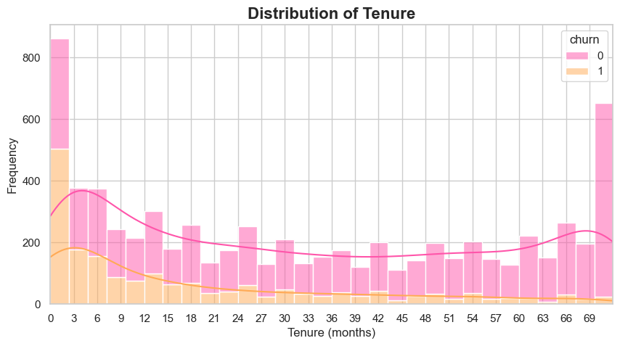
Tenure Distribution by Churn:
Customers with shorter tenure are more likely to churn. This pattern is particularly noticeable in the first few months.
Customers with longer tenure are more likely to stay, suggesting higher customer loyalty or satisfaction over time
As we can see after only one tenure period, customers starts churning rapidly, it means that many customers cancel the subscription in 1-2 months. to deal with that we can consider giving more discounts on long-term plans and make more customers to subscribe for long term plans.

Slide 11
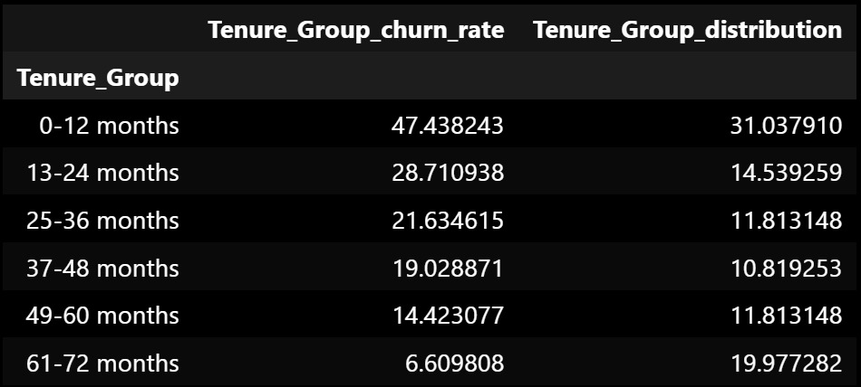
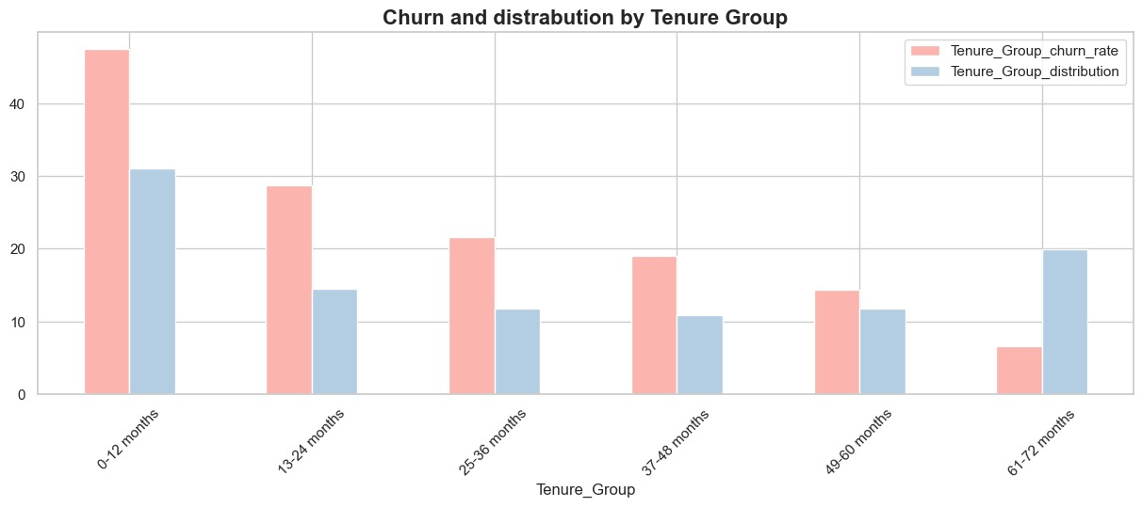
Tenure Bins
Due to Tenure distribution, we decide to categorized Tenure into 6 groups:
churn rate decreases significantly as the tenure increases.
Customers are more likely to churn in the initial months (0-12 months)
with the churn rate being the highest, and it gradually decreases as
they continue their services beyond 13 months.
After 60 months or 5 years, churn rate is relatively very low.

Slide 12
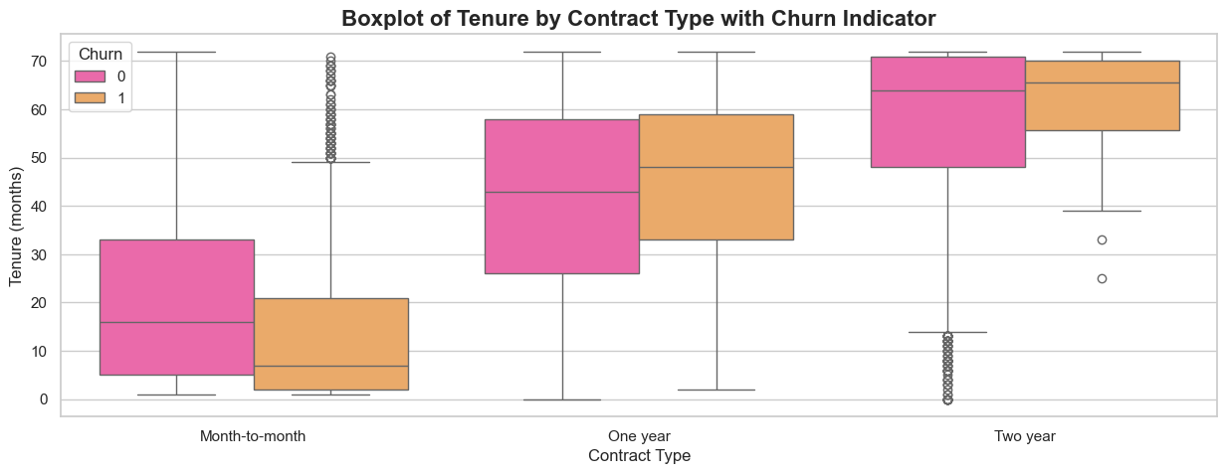
Tenure & contract type
Long-term contracts lead to better customer retention. Here's a breakdown by contract type:
1. Month-to-Month Contracts- Higher churn among new customers and non-churned customers display varied tenure, indicating some retention despite the contract’s flexibility.
2. One-Year Contracts: Churn occurs mostly among shorter tenures, though less dramatically than with month-to-month contracts. Longer tenures are common among non-churned customers, showing better retention.
3. Two-Year Contracts: Little difference in tenure between churned and non-churned customers, suggesting strong retention.
High median tenures for both groups indicate likely satisfaction and strong retention.

Slide 13
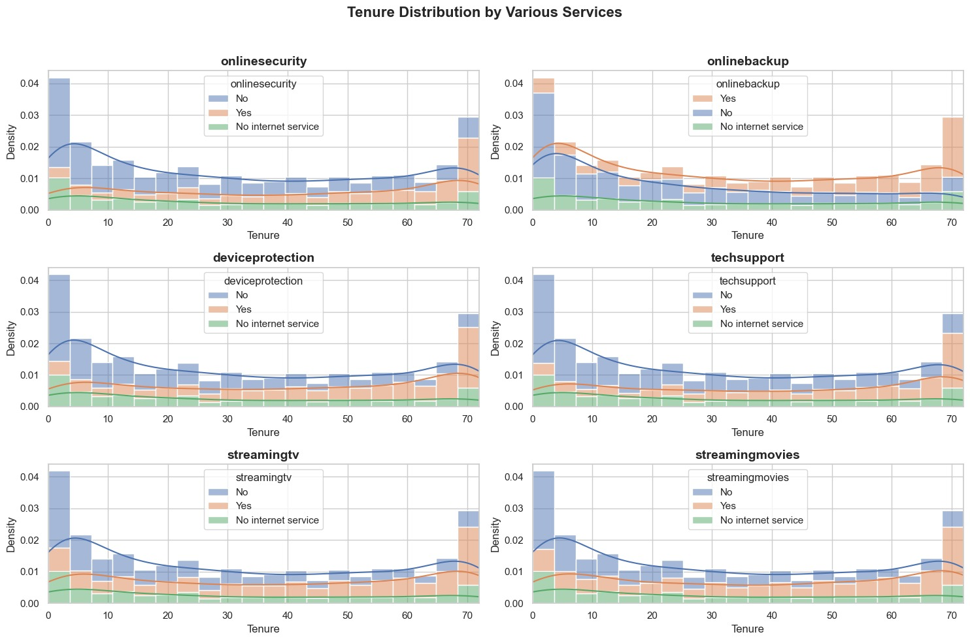
Tenure & services
Tenure & OnlineSecurity, OnlineBackup, DeviceProtection, TechSupport, StreamingTV, StreamingMovies
As we can see for all various services, new customer tend to avoid subscribing to multiple services and they simultaneously exhibit high churn rates.

Slide 14
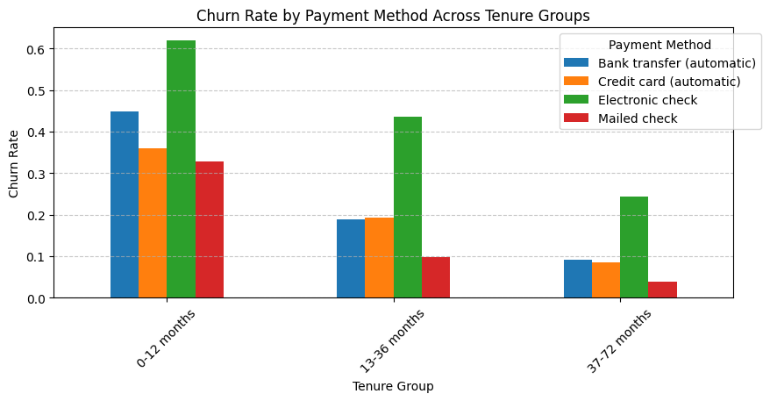
Tenure & Payment Methods
Electronic check payments are linked to higher churn rates across all tenure groups, possibly reflecting user issues or a demographic more likely to churn.
Mailed checks show moderate churn in early tenure but lower rates over time.
Automatic payments like bank transfers and credit cards maintain average churn rates, benefiting from convenience and reducing active decision-making.
Promoting automatic payment methods early in the tenure of electronic check users could help reduce churn.

Slide 15
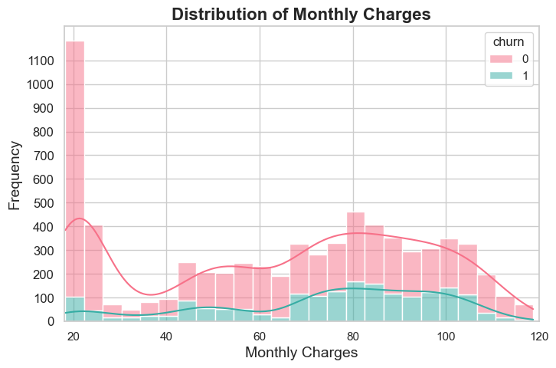
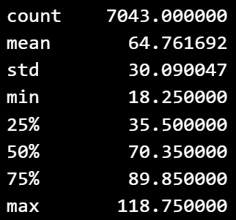
Monthly Charges Distribution by Churn:
Lower monthly charges are associated with a higher retention rate. Customers paying more each month show a higher tendency to churn, likely reflecting price sensitivity or dissatisfaction with the value provided.
The histogram indicates a wide range of monthly charges among customers, with a notable concentration of charges between roughly $20 and $30, and another significant grouping around $70 to $100. This suggests multiple common pricing tiers

Slide 16
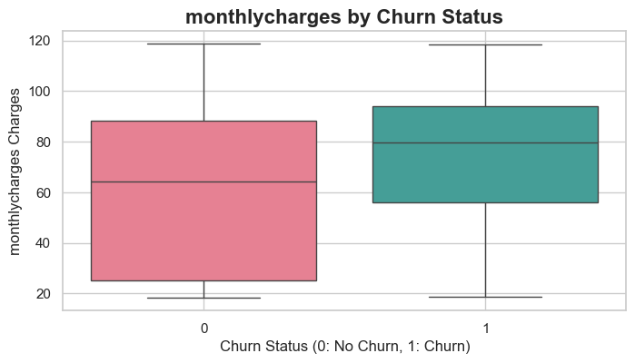
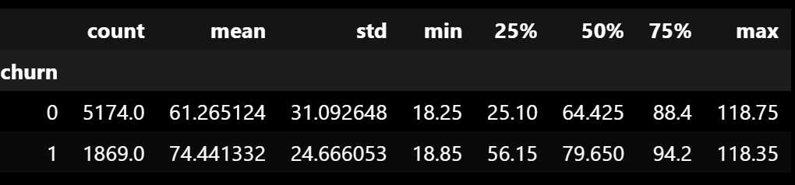
Monthly Charges Distribution by Churn:
The box plot indicates a difference in the distribution of 'MonthlyCharges' between customers who have churned and those who have not:Customers who churned generally had higher monthly charges.The spread and median are higher for churned customers, indicating that higher charges could be a factor in churn.Average MonthlyCharges for customers who have not churned: $61.27Average MonthlyCharges for customers who have churned: $74.44

Slide 17
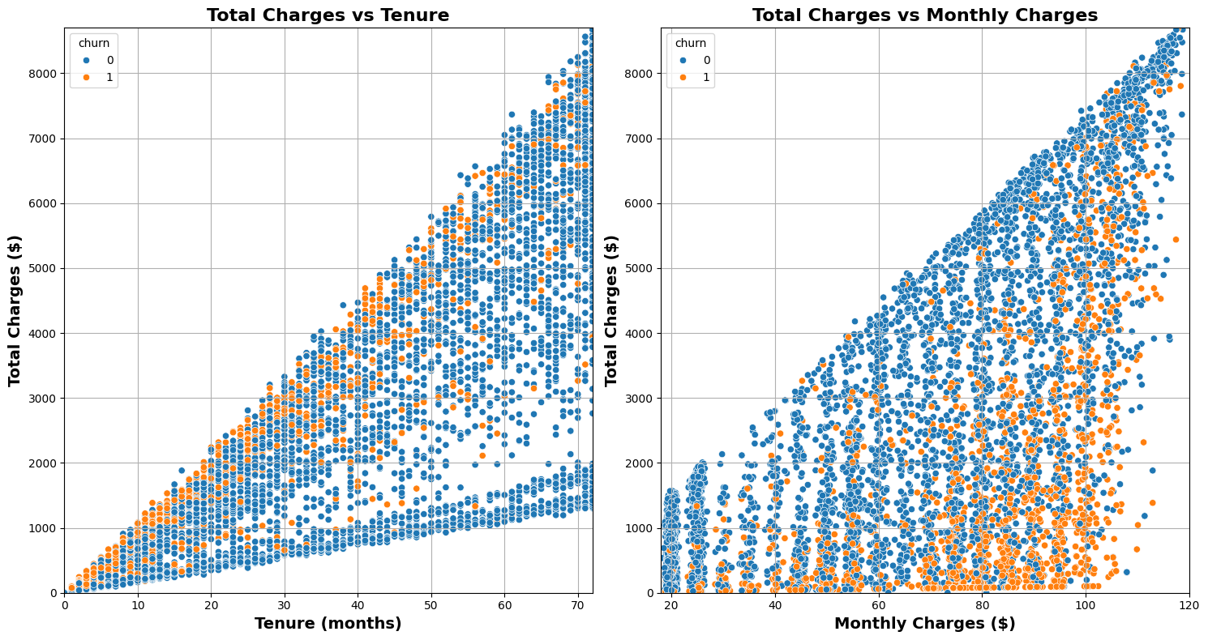
Total Charges Distribution by Churn:
TotalCharges vs Tenure
The relationship between TotalCharges and tenure indicates that total charges escalate with increasing tenure, aligning with more billing cycles over prolonged customer-company relationships. Churn appears predominantly in the lower to mid tenure range, hinting at a concentration of churn among customers who depart before incurring high total charges, potentially due to dissatisfaction with service or pricing.
TotalCharges vs MonthlyCharges
There is a linear relationship between TotalCharges and MonthlyCharges, with total charges rising alongside monthly charges. Higher churn rates among customers with elevated monthly charges suggest that higher costs may drive churn, possibly due to dissatisfaction with value or competitive offers elsewhere.

Slide 18
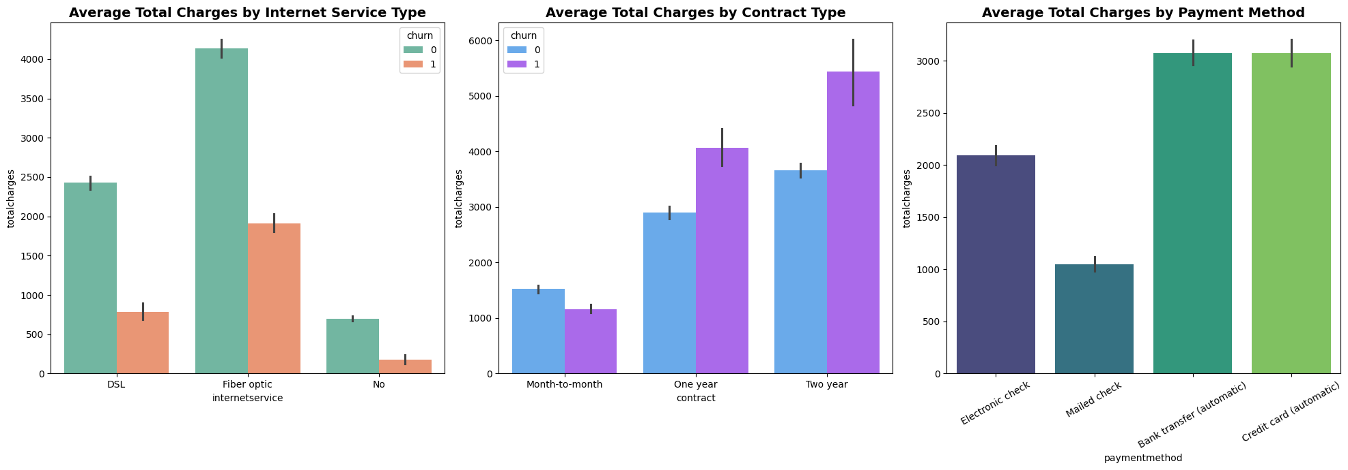
Total Charges Distribution by Churn:
Internet Service: Fiber optic users face higher charges, with churned users indicating dissatisfaction despite high costs.
Contract Type: Long-term contracts have higher charges but lower churn, whereas month-to-month contracts show higher churn with varied charges.
Payment Method: Lower charges are linked with electronic checks and higher churn, while automatic payments correlate with higher charges and reduced churn.

Slide 19
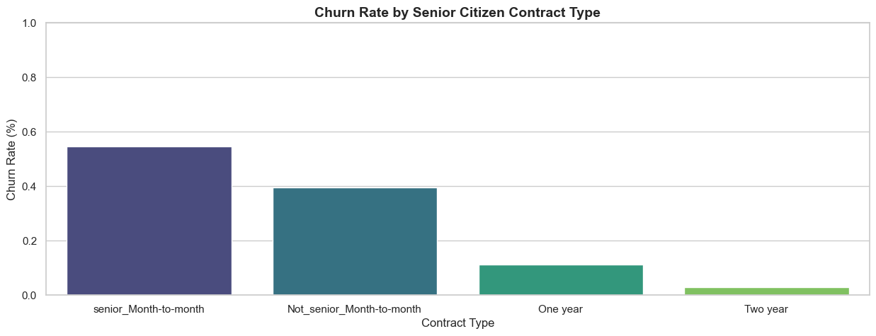
Senior Citizens & Contract Type
Senior citizens with month-to-month contracts are the most likely to churn, suggesting that this group might benefit from targeted retention strategies.
.

Slide 20
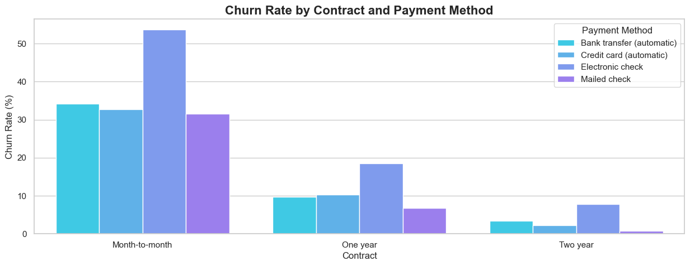
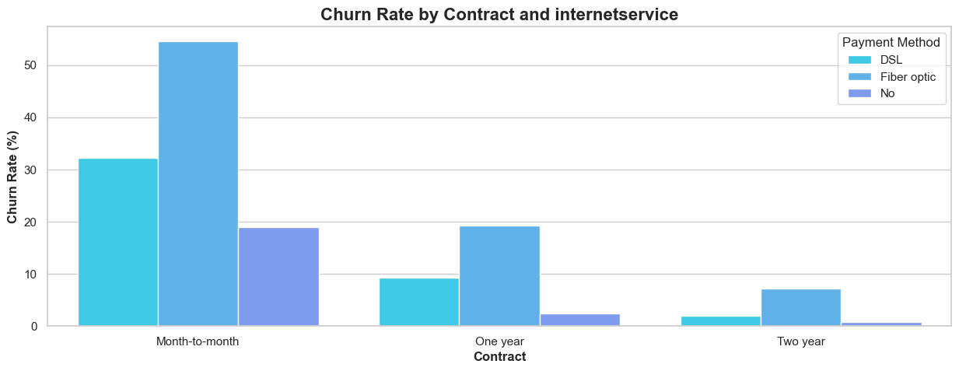
Contract Type, Payment Method & Internet
Contract Type & Payment Method: Customers with month-to-month contracts and those paying via electronic check are more likely to churn .the combination of Electronic check and Month-to-month contract is the most prone to customer churn. Automatic payment methods, especially with longer contract terms, seem to enhance customer retention
Contract Type & Internet Service: Senior citizens, especially those using fiber optic internet, tend to churn more, likely due to higher costs. Customers with longer contracts (one year and two years) tend to churn less compared to those with month-to-month contracts.
Add-On Services: Lack of additional services (online security, tech support, etc.) correlates with higher churn rates.

Slide 21
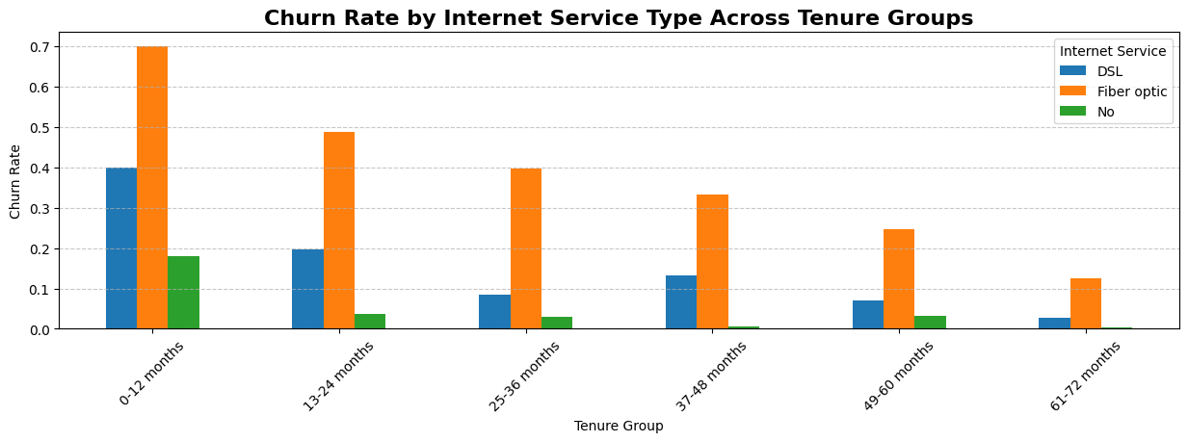
Internet Services
Customers on month-to-month contracts often opt for Fiber Optic internet, contributing to its higher churn rate, particularly among those without dependents. Despite its faster speeds, Fiber Optic's higher cost may lead to increased churn.
Conversely, those without internet service tend to have lower churn rates, possibly because of lower overall service costs.

Slide 22
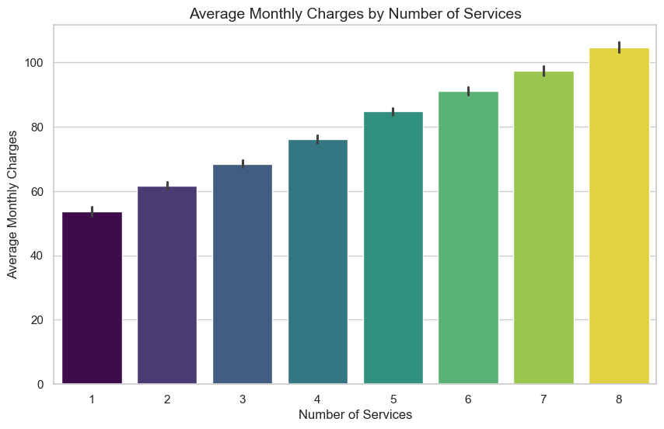
Services & Monthly Charges
We grouped services for customers with internet service, and assessed churn rates by the number of these additional services
Generally, customers without additional services like Online Security or Streaming TV exhibit higher churn, likely due to the higher costs associated with internet service alone.
Examining monthly charges integrate whit those services, we observe a consistent rise in average monthly charges with each added service. This trend underscores that each extra service contributes significantly to the monthly bill, implying they are likely premium offerings.

Slide 23
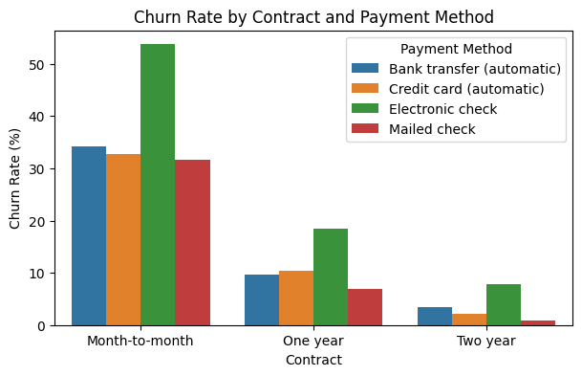
Contract & Payment Method
The combination of Electronic check and Month-to-month contract is the most prone to customer churn.
Automatic payment methods, especially with longer contract terms, seem to enhance customer retention.
People having month-to-month contract prefer paying by Electronic Check mostly or mailed check. The reason might be short subscription cancellation process compared to automatic payment.

Slide 24
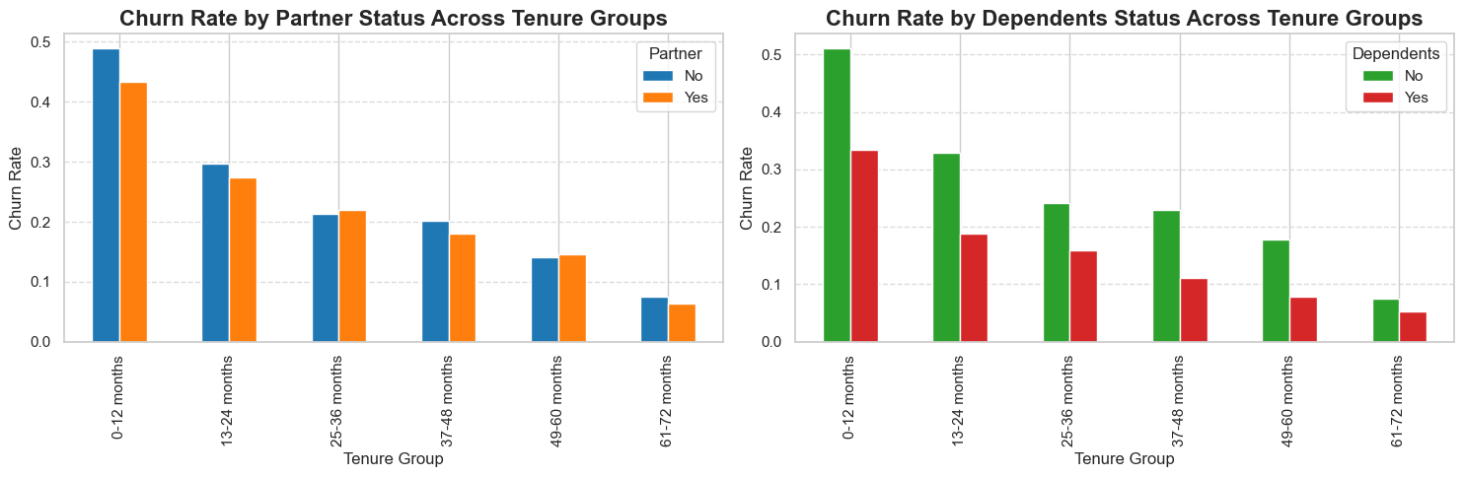
Contract & Payment Method
Customers with partners tend to have slightly lower churn rates across all tenure groups:
Customers with dependents consistently show lower churn rates compared to those without dependents, particularly as tenure increases
The analysis shows that both having a partner and having dependents are associated with lower churn rates, suggesting that these customers might have more stability or less inclination to change service providers, possibly due to shared service utilization or the complexities of changing services for a household rather than an individual

Slide 25
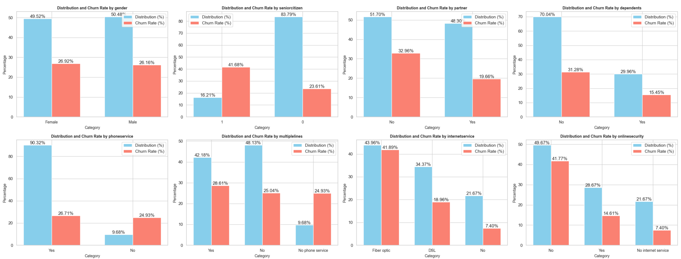
Distribution of various categorical variables

Slide 26
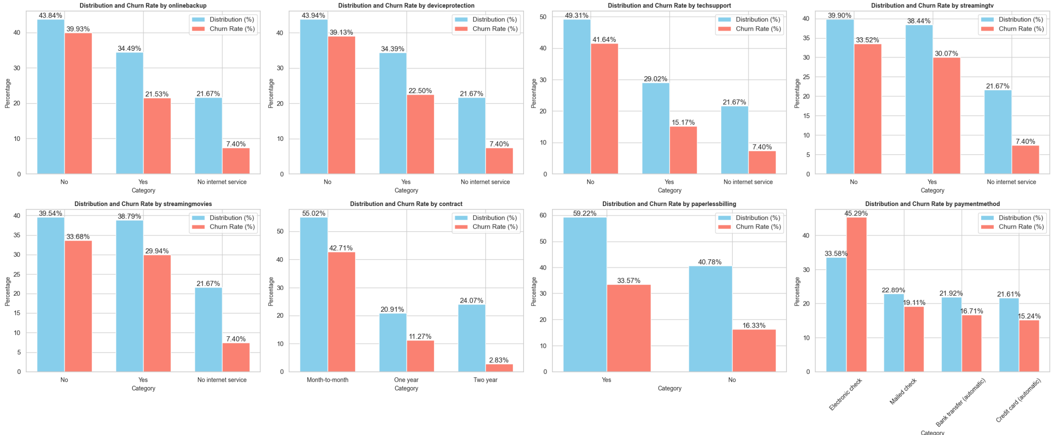
Distribution of various categorical variables

Slide 27
Insights from the EDA
Fiber optic internet users experience higher churn, likely due to its higher cost or reliability issues, emphasizing the need for enhanced customer support.
Compared to DSL, fiber optic's fast yet expensive nature contributes to higher churn rates.
Influence of Contract Length:
Month-to-month contracts exhibit the highest churn rates, reflecting the volatility of short-term customers who are more sensitive to dissatisfaction or price changes. Strategies to promote longer-term commitments could stabilize retention.
Payment Methods and Customer Loyalty:
Electronic checks are associated with higher churn rates due to perceived inconveniences or security issues. Automatic payment methods like bank transfers or credit cards result in lower churn, offering more convenience.
Demographic Factors:
Senior citizens show distinct churn patterns, likely due to different needs or service usage, pointing to the potential for tailored customer care.
Customers with families and lower tenure are less likely to churn, possibly due to greater financial stability or the hassle of changing services.

Slide 28
Insights from the EDA
Add-on Services:
The absence of services like online security, tech support, and streaming options correlates with higher churn. Enhancing these services or offering them in bundles could significantly reduce churn.
Phone Service and Multiple Lines:
Having phone service slightly increases churn rates, though not substantially. Customers with multiple lines exhibit more churn than those with single or no lines, suggesting dissatisfaction or cost concerns with additional services.
Paperless Billing:
Customers using paperless billing tend to churn more, possibly due to the demographics that opt for digital over traditional billing methods, which may also be more prone to switching services.
By addressing these factors, especially by enhancing service quality and offering more suited contract and payment options, churn rates could be effectively reduced across different customer segments.

Slide 29
DATA ENGINEERING -Transformation Steps:
Reload the CSV file
Convert all column names to lowercase.
Map 'Yes'/'No' values in 'Churn' converted to 1 and 0.
replacing non-numeric missing values in 'TotalCharges. with 0 and converting it to float type.
separate and remove the customer ID column
Missing values in the dataset where checked
After applying `get_dummies`, we obtain 46 columns.
We decide to remove some features and add new ones for better analysis.

Slide 30
DATA ENGINEERING- Removing Features:
1. We removed features with high correlations to avoid redundancy and improve the model's performance:
'onlinesecurity_Yes`
'onlinebackup_Yes`
'deviceprotection_Yes`
'techsupport_Yes`
2. Binary Pairs: Only one column from each pair was needed because they are perfectly negatively correlated:
`partner_No`
`dependents_No`
,phoneservice_No`
`paperlessbilling_No`
`streamingtv_No`
`streamingmovies_No`

Slide 31
DATA ENGINEERING- Removing Features:
3. Features with Opposite Correlations:
These columns have the same correlation with `phoneservice_Yes` but in the opposite direction:
multiplelines_No phone service`
4. These columns have the same correlation with `internetservice_No`:
'onlinesecurity_No internet service`
`onlinebackup_No internet service`
`deviceprotection_No internet service`
`techsupport_No internet service`
`streamingtv_No internet service`
`streamingmovies_No internet service
`
`

Slide 32
DATA ENGINEERING- Removing Features:
5. High Correlation with TotalCharges:
`tenure` and `totalcharges` have a high correlation (0.83), likely because total charges accumulate over time. While both are important, `totalcharges` is more comprehensive as it includes tenure information. Additionally, the calculated value of tenure * monthlycharges does not match `totalcharges`.
`tenure`
6. High Correlation Between MultipleLines Columns:
High correlation between `multiplelines_Yes` and `multiplelines_No` suggests dropping `multiplelines_No`. While `phone service` shows negligible impact on churn, other factors are more crucial for predicting churn`
`multiplelines_No`

Slide 33
DATA ENGINEERING - Adding New Features:
We added new features to enhance the predictive power of the model and capture additional aspects of customer behavior:
- `partner_Dependents`: sum of `partner_Yes` and `dependents_Yes`.1
Dropped `partner_Yes` and `dependents_Yes`
2. - `StreamingServices`: sum of `streamingtv_Yes` and `streamingmovies_Yes`
Dropped `streamingtv_Yes` and `streamingmovies_Yes`
3. PaymentMethod_automatic`: sum of `paymentmethod_Bank transfer (automatic)` and `paymentmethod_Credit card (automatic)`
Grouped payment methods into `Automatic` vs. `Not Automatic`. The correlation matrix shows a perfect negative correlation (-1.00000) between `PaymentMethod_automatic` and `PaymentMethod_Not_automatic`. This is expected because these two features are likely inversely related; when one is true, the other is false, and they effectively represent the same information in opposite forms. Thus, we dropped `PaymentMethod_Not_automatic` which included `paymentmethod_Electronic check` and `paymentmethod_Mailed check`.

Slide 34
DATA ENGINEERING - Adding New Features:
Dropped `paymentmethod_Bank transfer (automatic)`, `paymentmethod_Credit card (automatic)`, `paymentmethod_Electronic check`, `paymentmethod_Mailed check`
4. Additional Services (only for customers with internet service)
- Sum of `onlinesecurity_No`, `onlinebackup_No`, `deviceprotection_No`, `multiplelines`, `techsupport`, `StreamingServices`
We removed 27 columns with high correlations and redundancy and added 4 new features to enhance the model's predictive accuracy.
Addressing Missing Values:
We addressed missing values primarily occurring among customers with a tenure of 0 and churn status of 0 by imputing these values with the product of monthly charges and tenure. This approach ensures data consistency and accuracy for subsequent analyses and modeling tasks.
After this process of addressing missing values and adjusting the features, we have 23 columns remaining in the dataset.

Slide 35
Explanations:
Online Security and Tech Support:
Lack of online security (0.343) and lack of tech support (0.337) are both positively correlated with churn. This suggests that customers without these services are more likely to leave.
Payment Method:
Electronic check payment method has a positive correlation with churn (0.302), indicating that customers who use this payment method are more likely to churn compared to those using automatic payment methods like bank transfer or credit card.
Online backup & device protection:
Lack of online backup (0.268) and lack of device protection (0.252) are also positively correlated with churn, suggesting the importance of these additional services in customer retention.

Slide 36
Explanations:
Monthly and Total Charges:
Monthly charges (0.193) and total charges (0.198) have a positive but smaller correlation with churn, indicating that higher charges may contribute to churn but are not the primary factors.
Demographics
Senior citizen status has a smaller positive correlation (0.151) with churn, indicating that senior citizens are slightly more likely to churn.
Dependents & partner status have smaller correlations, suggesting that while these factors do influence churn, they are not the strongest predictors.
Gender, phone service, and multiple lines have very low correlations with churn, indicating they have little to no impact on whether a customer will churn.

Slide 37
ML ALGORITHMS
We explore the performance of three machine learning algorithms for predicting customer churn
Our objective is to identify the most effective algorithm for predicting churn based on our dataset.
Decision Tree:
Tree is a tree-like structure where internal nodes represent features, branches represent decision rules, and leaf nodes represent outcomes.We will vary the maximum depth of the decision tree to evaluate its performance under different complexities.
K Nearest Neighbors (KNN):
KNN classifies objects based on the majority class among its k nearest neighbors.
We will experiment with different values of k to observe their impact on prediction accuracy.
Random Forest:
Random Forest is an ensemble method that constructs multiple decision trees and outputs the mode of the classes or the mean prediction.
We will adjust the maximum depth of the trees and try different numbers of estimators to find the optimal configuration

Slide 38
ALGORITHMS INTROSPECTION- Evaluatation
We evaluate three different algorithms: K-Nearest Neighbors, Decision Tree, and Random Forest, each with specified parameters.
Split the dataset into training and testing sets.
Test K-Nearest Neighbors with n_neighbors values of 51, 101, and 301.
Test Decision Tree with max_depth values of 6, 7, and 8.
Test Random Forest with max_depth values of 5, 9, and 21 and n_estimators set to 100.

Slide 39
Evaluate the performance of each model:
K-Nearest Neighbors (KNN):
n_neighbors = 51 - Accuracy: 79.20%
n_neighbors = 101 - Accuracy: 78.06%
n_neighbors = 301 - Accuracy: 77.57%
Decision Tree:
max_depth = 6 - Accuracy: 78.49%
max_depth = 7 - Accuracy: 77.78%
max_depth = 8 - Accuracy: 77.64%
Random Forest n_estimators set to 100
max_depth = 5 Accuracy: 78.99%
max_depth = 9 - Accuracy: 79.41%
max_depth = 21 - Accuracy: 77.50%

Slide 40
Evaluate the performance of each model:
Summary
Best K-Nearest Neighbors: neighbors=51 with an accuracy of 79.2%.
Best Decision Tree: max_depth=6 with an accuracy of 78.49%.
Best Random Forest: n_estimators=100 and max_depth=9 with an accuracy of 79.41%.

Slide 41
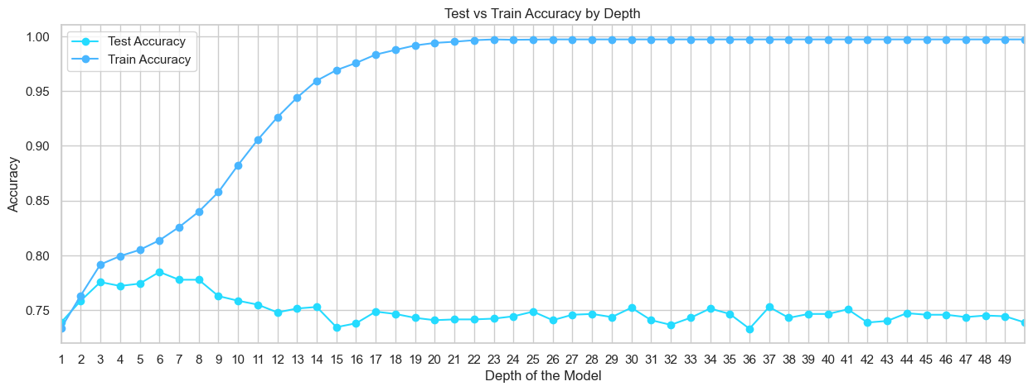
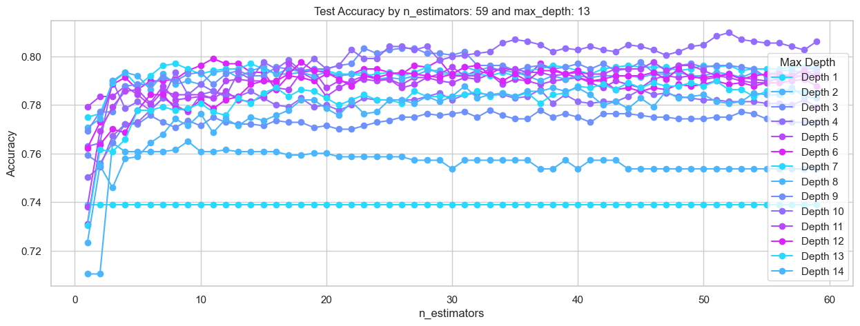
Over Fitting
Decision Tree: max_depth: 6, accuracy 78.49%
Random Forest: n_estimators=52 and max_depth=10 accuracy 80.797%

Slide 42
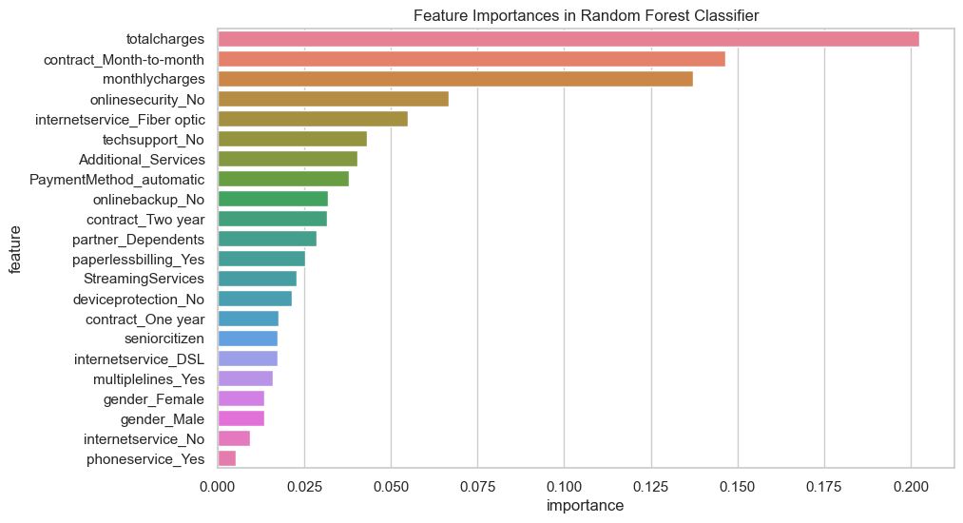
Over Fitting
Random Forest: Feature Importances
FEATURE | IMPORTANCE
totalcharges | 0.202464
contract_Month-to-month | 0.146546
monthlycharges | 0.137237
onlinesecurity_No | 0.066686
internetservice_Fiber optic | 0.054959
techsupport_No | 0.042986
Additional_Services | 0.040284
PaymentMethod_automatic | 0.037864
onlinebackup_No | 0.031761
contract_Two year | 0.031582
partner_Dependents | 0.028667
paperlessbilling_Yes | 0.025341
StreamingServices | 0.022712
deviceprotection_No | 0.021550
contract_One year | 0.017505
seniorcitizen | 0.017248
internetservice_DSL | 0.017212
multiplelines_Yes | 0.015986
gender_Female | 0.013549
gender_Male | 0.013380
internetservice_No | 0.009348
phoneservice_Yes | 0.005133

Slide 43
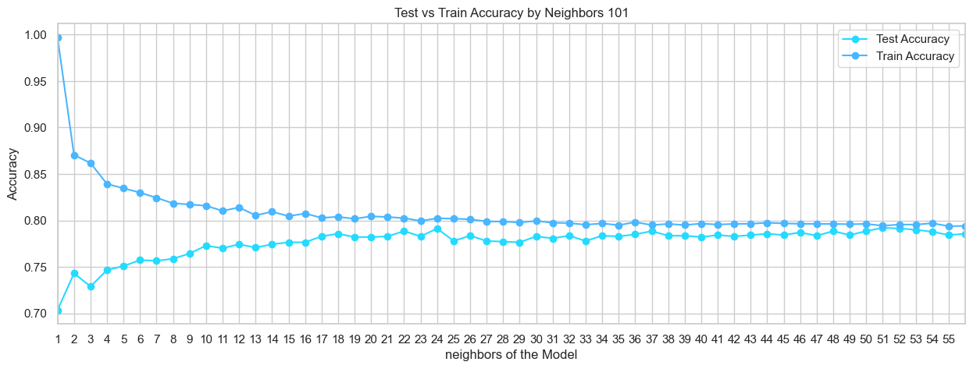
Over Fitting
K-Nearest Neighbors (KNN): n_neighbors = 51 - Accuracy: 79.20%

Slide 44
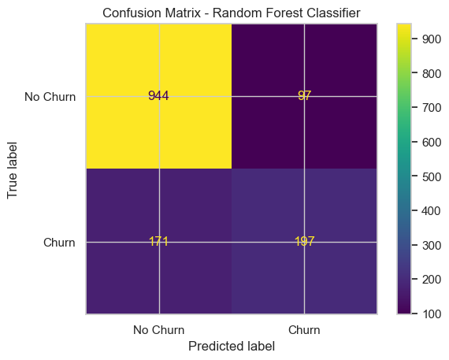
Confusion Matrix
SUMMARY ML ALGORITHMS BEST RESULTS
RandomForest – Confusion Matrix
True Negatives (TN): 944 - The model correctly predicted that 944 customers would not churn.
False Positives (FP): 97 - The model incorrectly predicted that 97 customers would churn when they actually did not.
False Negatives (FN): 171 - The model incorrectly predicted that 171 customers would not churn when they actually did.
True Positives (TP): 197 - The model correctly predicted that 197 customers would churn.

Slide 45
Part B: MongoDB

Slide 46
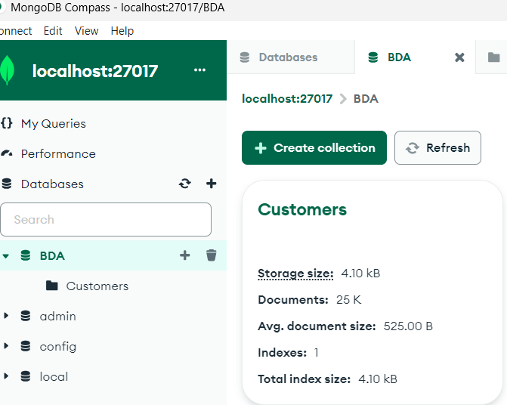
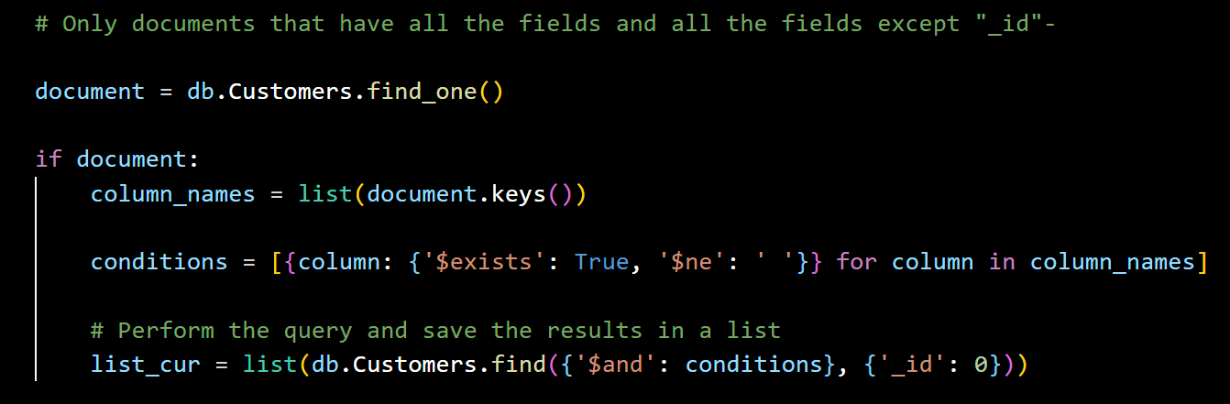
Creating MongoDB Database and Collection
We opened MongoDB Compass and created a new database called `BDA`.
Within this database, we created a collection named `Customers` and imported the `churn.json` file into it.
we set up a VS code and installed the `PyMongo` library and connected to MongoDB.
Using PyMongo, write MQL query (Mongo Query Language) that returns:
Only documents that have all the fields.
Remove 1,577 documents that do not have the "Payment Method" field.
Remove 5 documents where the "Total Charges" field is an empty string.
All the fields except "_id".
After these removals, 23,418 customers remain that have all the necessary fields.

Slide 47
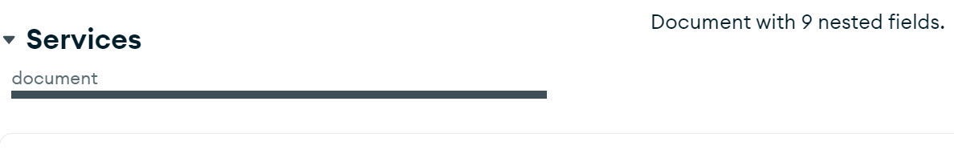
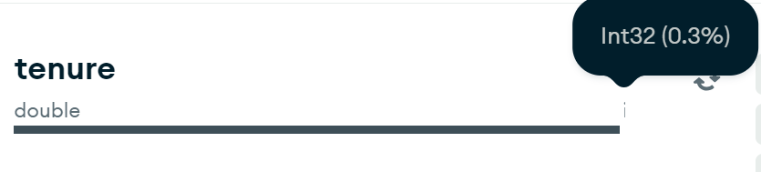
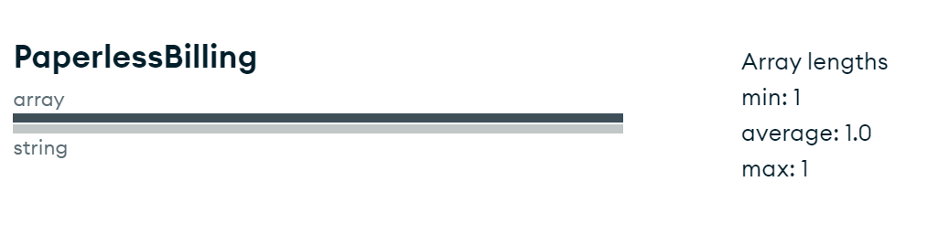
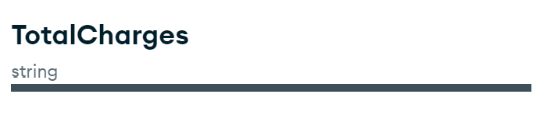
Use MongoDB Compass to analyze the scheme
PaymentMethod :6% don't have "Payment Method" field
Services Document with 9 nested fields- (by using json_normalize we "fix" the columns name)
tenure about 0.3% of the documents - integer type
PaperlessBilling Array lengths size 1 with average: 1.0 with string 'Yes' or ‘No’- need to convert to string
TotalCharges datatype is String

Slide 48
Prep the df to be used in ML model
We built three functions to handle data preparation for the two CSV files and use the best model, with the highest accuracy (from "Python Project - Part I").
Data preparation:
df_prep(df):
This function processes the DataFrame by cleaning and converting the data:
Converts column names to lowercase.
Converts the total loads into numbers and fills in missing values.
Maps the churn column to binary values ​​if it exists.
Temporarily removes the customerID column.
Applies one-hot coding to categorical variables.
Converts Boolean columns to integers.
Drops unnecessary columns.
Incorporates new column-specific features for improved analysis.
Rejoins the Customer ID column and rearranges the DataFrame columns.
df_prep(customers_df) and df_prep(churn_df) are used to prepare the customer and churn datasets respectively.

Slide 49
Prep the df to be used in ML model
Training and prediction models:
predict(x_train, y_train, x_test, customers):
This function trains a random forest model using the provided training data (x_train, y_train).
It then predicts churn for the test data (x_test) and combines the predictions with the customer data.
The resulting DataFrame includes a new column, Churn, indicating whether each customer is likely to churn.
Feature Importance:
Feature_Importances(x_train, y_train):
This function trains a random forest model and extracts the importance of features.
This creates a DataFrame listing each attribute and its importance, sorted in descending order.
The resulting DataFrame helps identify which features contribute most to predicting churn.
Exporting the final DataFrame:
After preparing the data, predicting churn and identifying feature importance, the final DataFrame is exported to a CSV file for further analysis or reporting.

Slide 50
df_prep Function- Explanation In part A, we removed tenure- however, we are not removing it here (due to low correlation) because the correlation between TotalCharges and MonthlyCharges * tenure is almost zero (in part A, it was 99%)
Lowercase Column Names- Converts all column names to lowercase.
Convert and Handle `totalcharges`: Converts `totalcharges` to numeric, handling errors by filling them with `tenure * monthlycharges`.
Map `churn` Column: If the `churn` column exists, maps its values from 'Yes'/'No' to 1/0.
Store and Drop `customerid`- Stores the `customerid` column and drops it from the DataFrame.
One-Hot Encode Categorical Variables:- Applies one-hot encoding to categorical variables.
Convert Boolean Columns to Integers- Converts boolean columns to integers.
Drop Unnecessary Columns- Drops columns that are redundant or not needed for the analysis.

Slide 51
df_prep Function- Explanation
Combine Features:
`partner_Yes` and `dependents_Yes` into `partner_Dependents`.
`streamingtv_Yes` and `streamingmovies_Yes` into `StreamingServices`.
Payment methods into a single `PaymentMethod_automatic` column.
Calculates `Additional_Services` based on various service indicators.
Rejoin `customerid`- Rejoins the `customerid` column to the DataFrame.
Reorder and Select Columns- Selects and reorders columns for the final DataFrame output, ensuring consistency.

Slide 52
predict Function - Explanation
Import Libraries- Imports necessary libraries from `sklearn` for model training and evaluation.
Train Random Forest Model- Trains a `RandomForestClassifier` with specified parameters on the training data.
Predict on Test Data - Predicts churn on the test data.
Save and Join Predictions- Saves the predictions in a DataFrame and joins them with the `Customers` DataFrame.
Reorder and Rename Columns- Reorders and renames columns to match the original dataset format.
Type Conversions:- Converts `TotalCharges` to string, `tenure` to integer, and maps `Churn` from 0/1 to 'No'/'Yes'.

Slide 53
Feature_Importances Function- Explanation
Import Libraries - Imports necessary libraries from `sklearn` for model training.
Train Random Forest Model - Trains a `RandomForestClassifier` with specified parameters on the training data.
Extract Feature Importances- Extracts the feature importances from the trained model.
Create DataFrame- Creates a DataFrame with features and their importances.
Sort and Return- Sorts the DataFrame by importance in descending order and returns it.

Slide 54
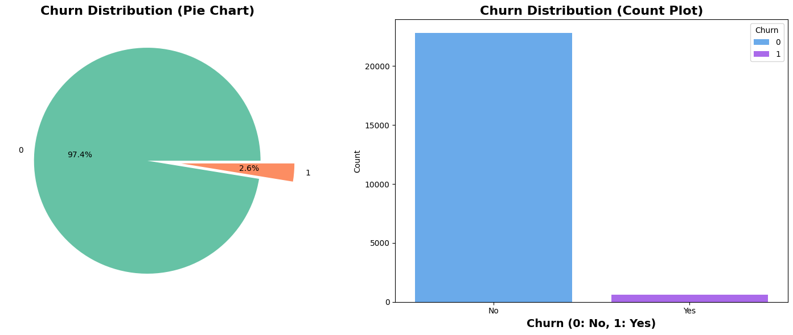
Customers - Churn Rate
We have 23,418 customers, from them 602 customers was churn, approximately 2.6%

Slide 55
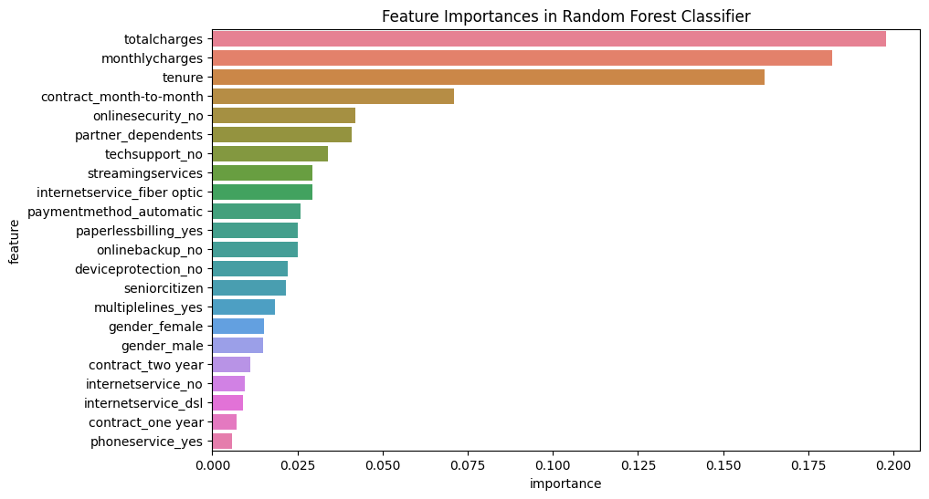
RandomForestClassifier model
we performed one-hot encoding on our data and then split it into features (X) and target (y), followed by further splitting into training and testing sets. We trained a RandomForestClassifier model on the training data and used it to predict churn on the test set, subsequently evaluating the model's accuracy. then added the predicted churn column to the original DataFrame and integrated this new data with the existing dataset for further analysis. Finally, we saved the final DataFrame with the predicted churn to a CSV file for future use.

Slide 56
Part C: Spark and Pycountry

Slide 57
Cleaning and preparing data
project's target
The goal was to clean and prepare the "churn_location_and_rating.csv" data for analysis in Tableau, while ensuring the quality and usability of the data.
Environment setting:
Created a Google Colab notebook and set up a Spark environment to efficiently handle data processing.
Loading data:
A connection was established between Colab and Google Drive.
Import the "churn_location_and_rating.csv" file into Spark DataFrame.

Slide 58
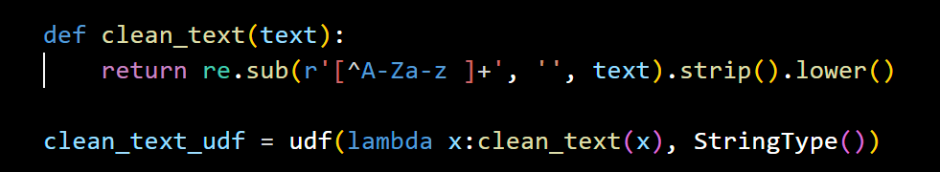
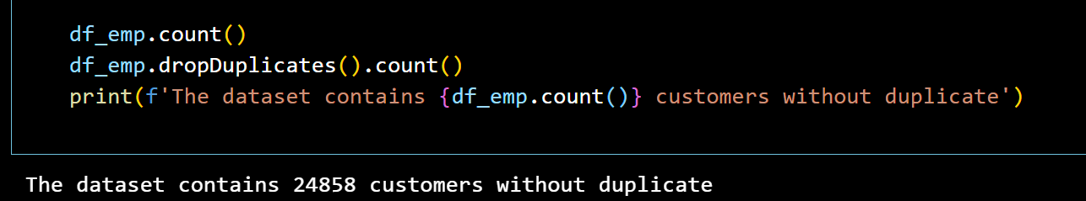
Cleaning and preparing data
Cleaning data:
Null values ​​handled:
Removed rows containing null values ​​to ensure data integrity.
Duplicate Rows Removed: Duplicate entries have been eliminated to maintain data integrity.

Slide 59
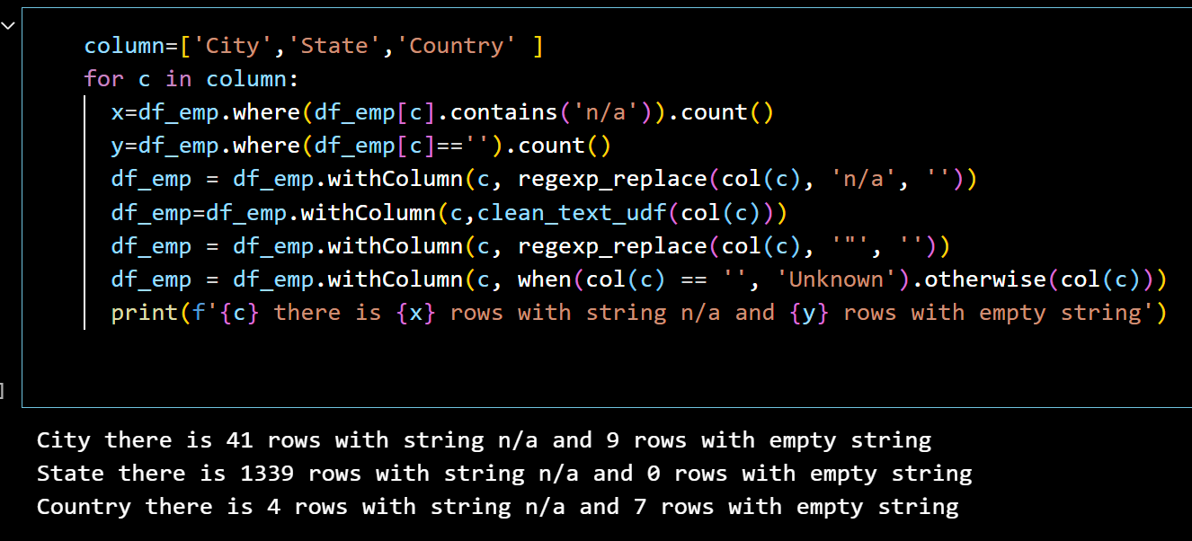
data cleaning steps
Also we replaced 'n/a' with an empty string, empty values with 'Unknown‘, and removed the character “ “ if it was exists.

Slide 60
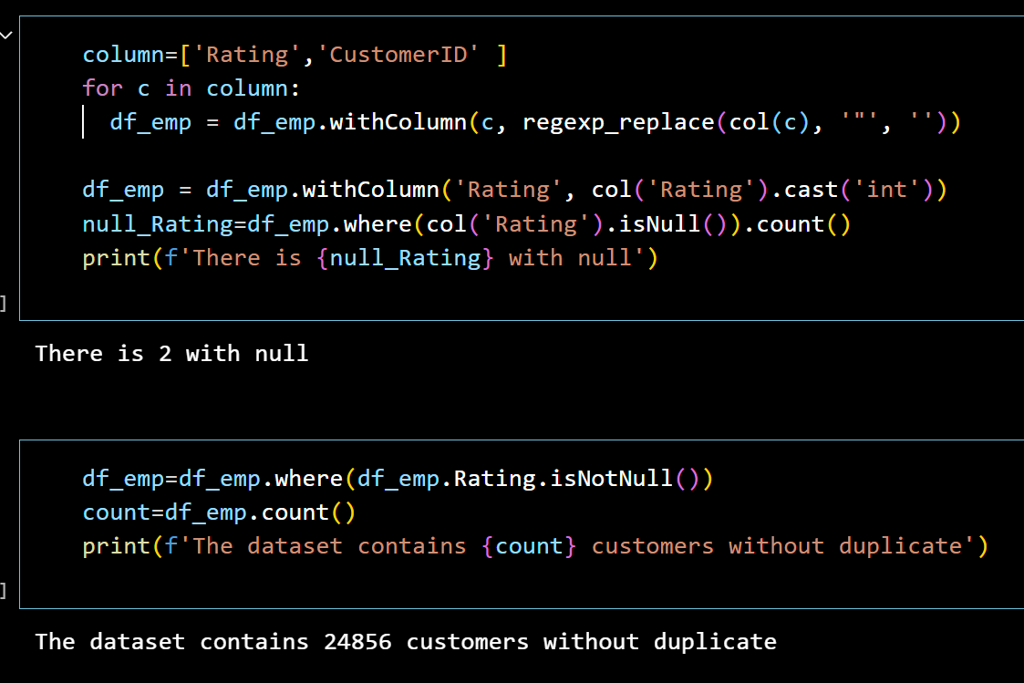
data cleaning steps
There weren't any Duplicate rows.
In 'Rating' column we Convert the values from string to int, ratings are in the range of 1-10.

Slide 61
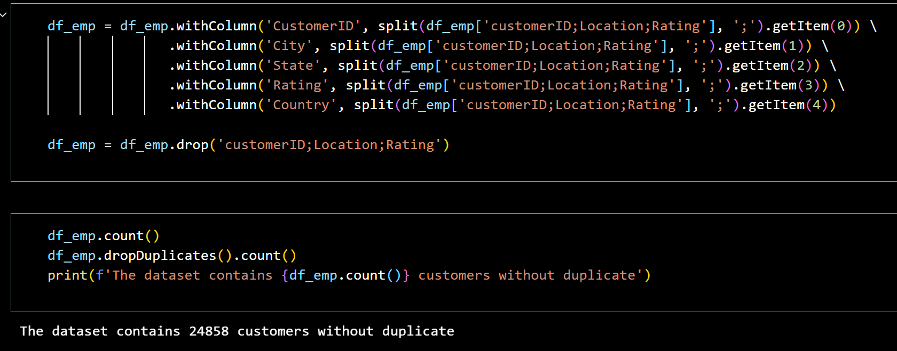
Cleaning and preparing data
Transformation of data:
Split Columns: Split the 'Location' column into separate columns for CustomerId, Country, State and City for better organization.

Slide 62
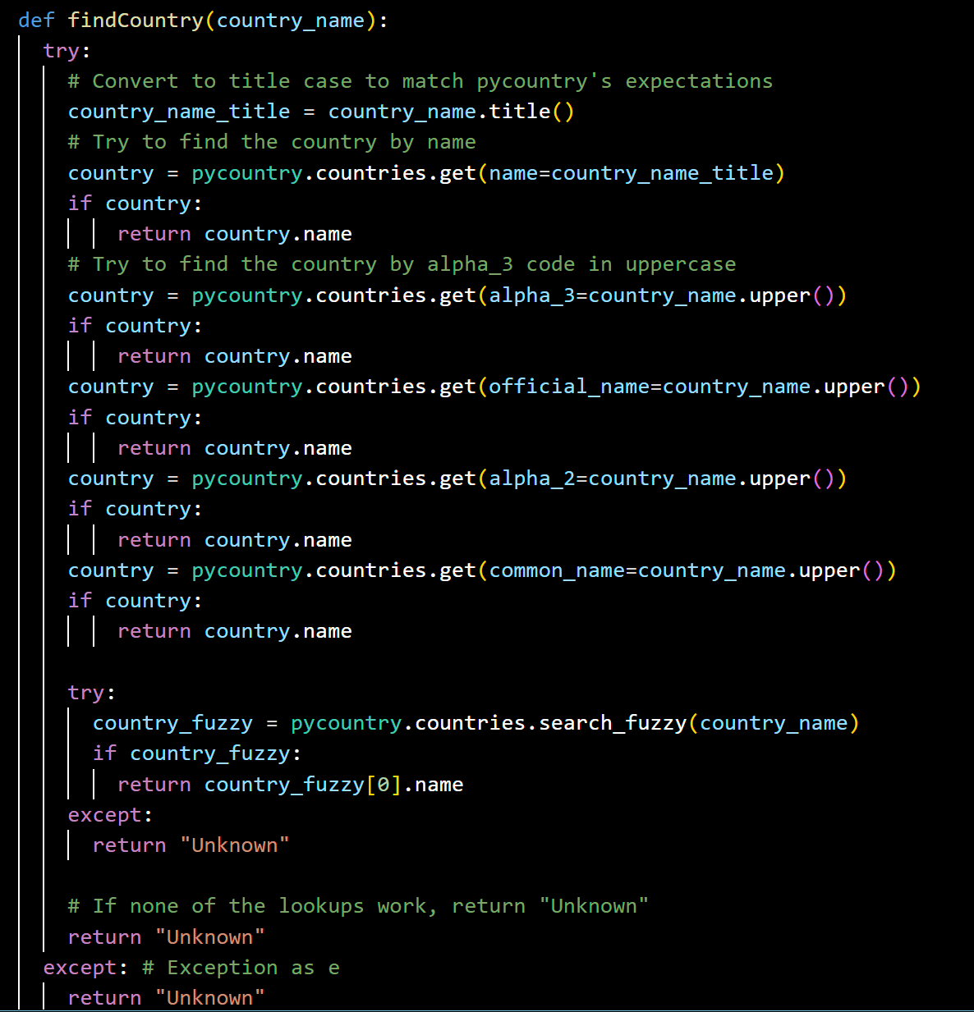
PyCountry library
To ensure all countries are correctly written, we used the `pycountry` library, which provides access to ISO countries, subdivisions, and currency information.
We use the `FindCountry` function to find the country by name or country code. If not found, it tries a fuzzy search. If the country is not found by any method, the function returns "Unknown". If not needed, it retains the original value of the 'Country' column.
The function is wrapped in a PySpark UDF, enabling data cleaning and standardization for country data.

Slide 63
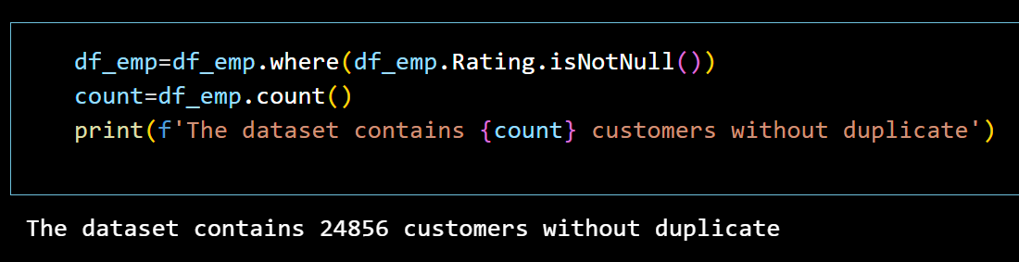
Cleaning and preparing data
Data integrity is maintained:
Ensured that the ratings, which range from 1 to 10, remained unchanged to preserve the accuracy of customer feedback.
Clean data export:
Export the cleaned DataFrame to a CSV file, making it ready for further analysis in Tableau.

Slide 64
Part D: Tableau

Slide 65
Tableau Prep
Connect with Tableau Prep to:
a. Customers.csv (the one we created in "MongoDB Project - Part B")
b. churn_location_and_rating.csv (the one we created in "Spark Project Part C)
Create the necessary mashups and transformation to be concluded in a Star Scheme model – performing Left join between Customers and churn_location_and_rating
Null values in country, city, state handled by replace with "Unknown“ and Rating with median and handling duplicated rows
it’s include creating ‘SK’ Key for each table
Create 4 Hyper Files that will be the base for the analysis in Tableau Desktop:
a. Dim_Customers
b. Dim_Services
c. Dim_Contract
d. Fact

Slide 66
Tableau Prep
Standardize InternetService Values and Phone services:
IF [PhoneService] = 'No' THEN 'No'
ELSEIF [PhoneService] = 'Yes' AND [MultipleLines] = 'No phone service' THEN 'No'
ELSE [MultipleLines] END
For example OnlineSecurity Standardize:
IF [InternetService]='No' THEN 'No'
ELSEIF [OnlineSecurity]='Yes' THEN 'Yes'
ELSE 'No' END
** internet services : OnlineBackup, DeviceProtection, TechSupport, StreamingTV and StreamingMovies

Slide 67
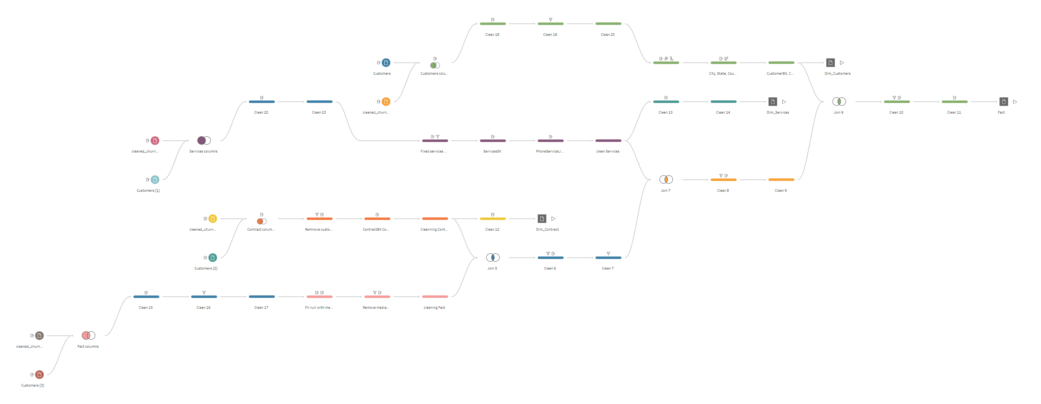
Tableau Prep

Slide 68
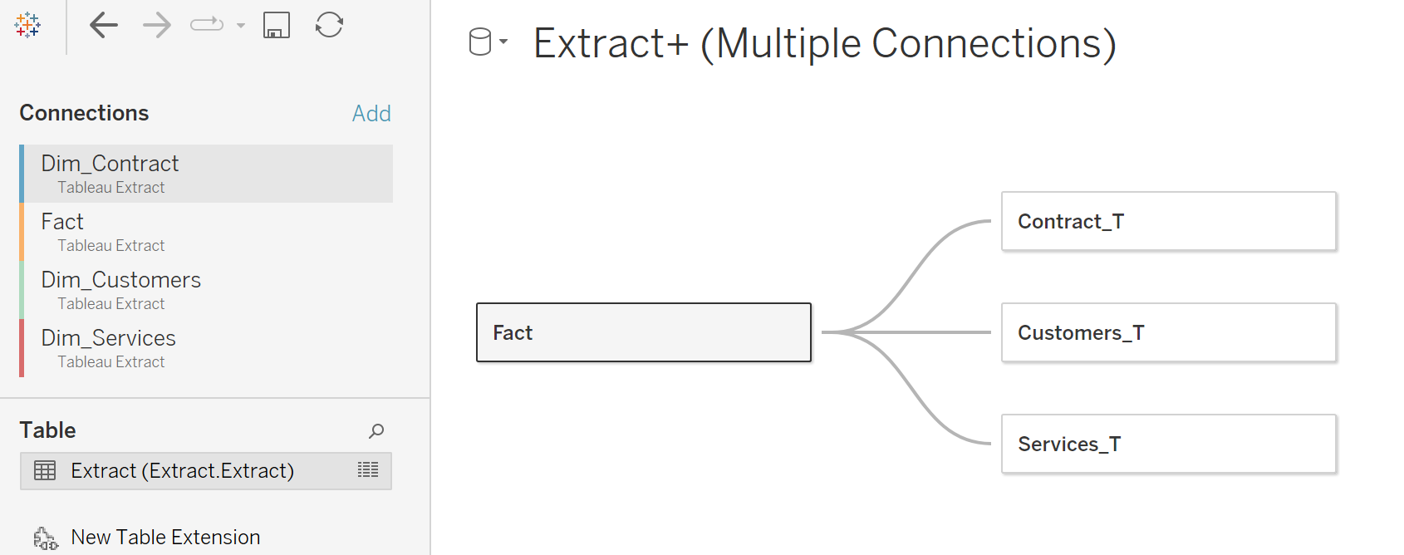
Tableau Desktop
Connecting to Data - Creating Connection to Data Source (model) with 4 Hyper files:

Slide 69
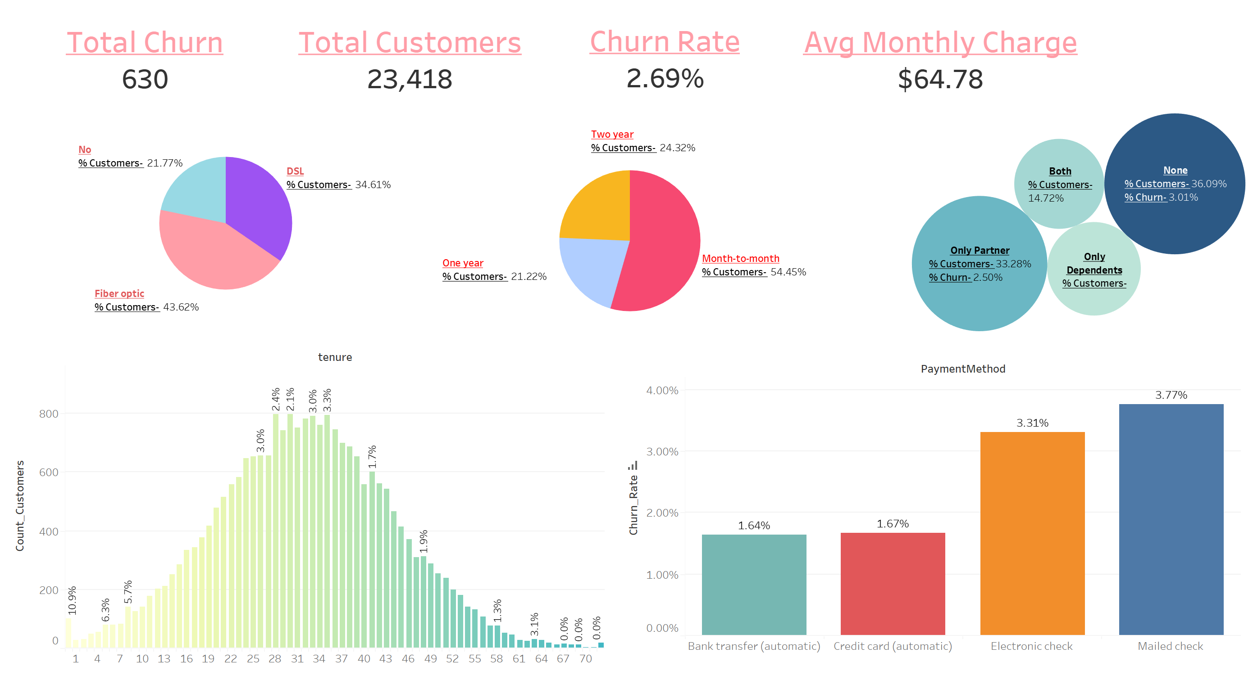
Analysis in Tableau

Slide 70
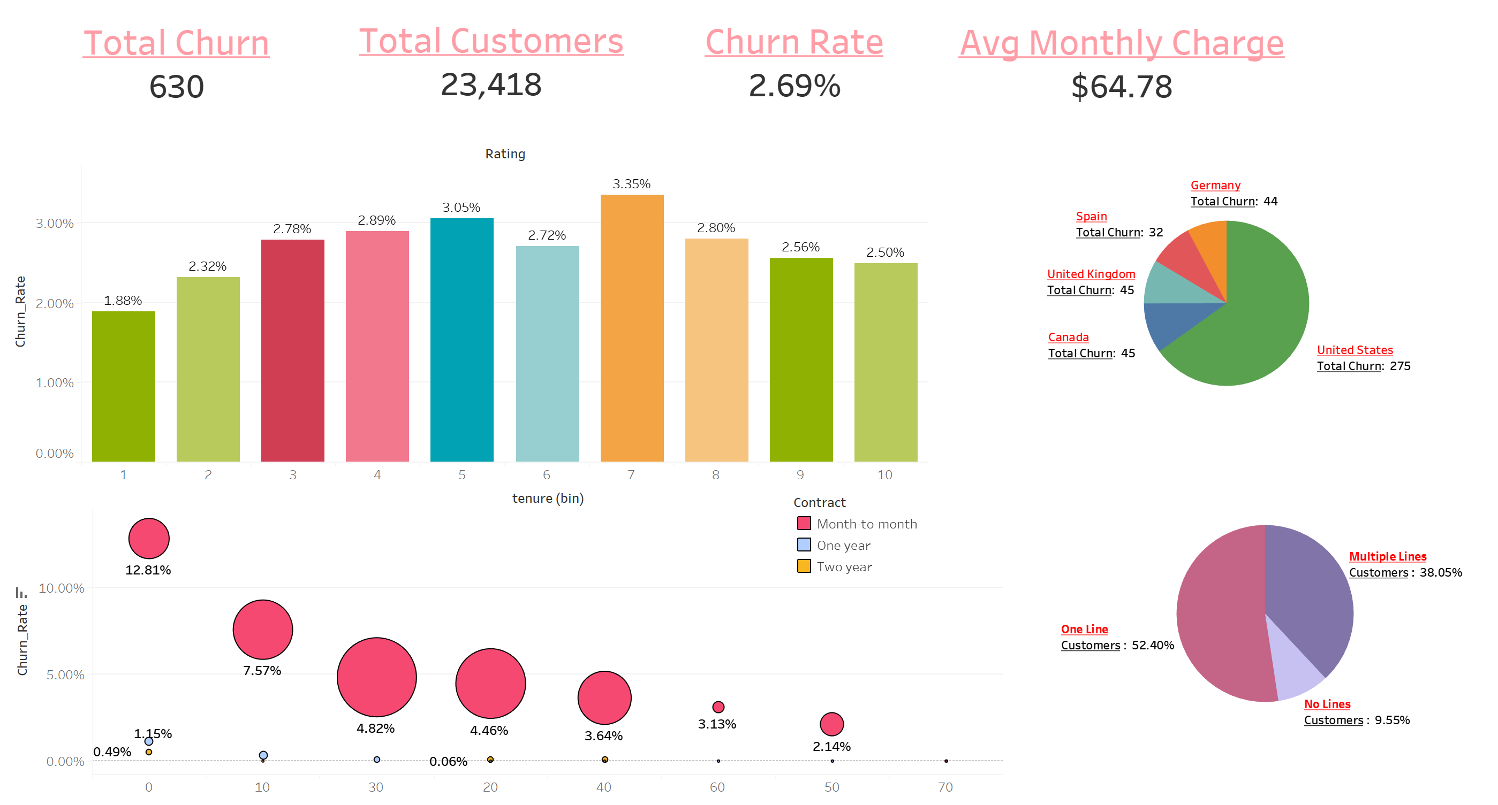
Analysis in Tableau

Slide 71
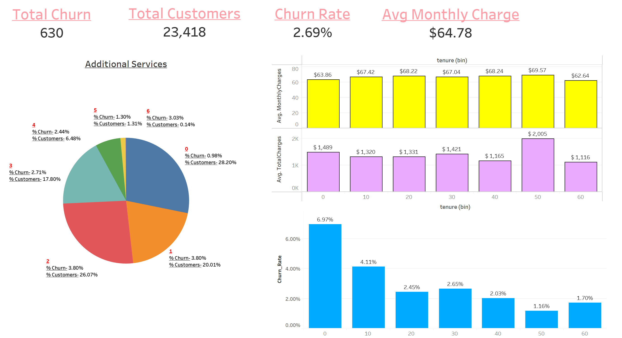
Analysis in Tableau

Slide 72

Analysis in Tableau

Slide 73

Analysis in Tableau

Slide 74

Analysis in Tableau

Slide 75

Conclusion
Total Churn and Customers
Total Churn: 630 customers out of 23,418.
Churn Rate: 2.69%.
Customer Distribution by Internet Service
Fiber optic: 43.62% of customers, higher churn rate.
DSL: 34.61% of customers, moderate churn rate.
No Internet Service: 21.77% of customers, lower churn rate.
Contract Type and Churn
Month-to-month contracts: Highest churn rate (54.45% of customers).
**98.73% of customers who churn have month-to-month contracts
One year contracts: 21.22% of customers.
Two year contracts: 24.32% of customers, lowest churn rate.

Slide 76
Conclusion
Payment Methods
Mailed check: Highest churn rate. (3.77%)
Electronic check: churn rate (3.31%).
Credit card (automatic): Lower churn rate (1.67%).
Bank transfer (automatic): Lowest churn rate (1.64%).
Tenure and Churn
Customers with less than 1 year tenure have the highest churn rate (6.24%).
Churn rate decreases significantly after 1 year and further decreases after 2 years.
Additional Services Impact
Customers without additional services like OnlineSecurity, TechSupport and PhoneSevice have higher churn rates.
DeviceProtection and Streaming services also show a noticeable impact on churn rates.

Slide 77
Conclusion
Demographics and Churn
Senior Citizens: Higher churn rate (3.94%).
Gender: Similar churn rates for male (2.64%) and female (2.74%).
Dependents: Customers without dependents have a higher churn rate (2.76%).
Partner: Customers without a partner have a slightly higher churn rate (2.81%).
Geographic Distribution
United States 47% of the customers are from USA : Highest number of churns -275.
Key Factors Influencing Churn.
Service Tenure: New customers (<1 year) are more likely to churn.
Additional Services: Lack of online security, backup, and tech support increase churn likelihood.
Demographics: Senior citizens and customers without dependents or partners have higher churn rates.

